Slide 1
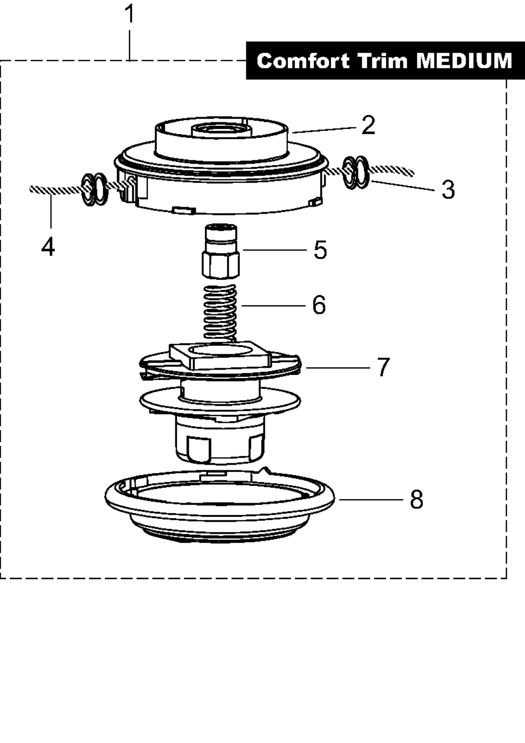
Oranžové šípky

Slide 2
Line trimming heads DOLMAR - 3l Tap&Go Comfort Trim "Medium" 381224240
Pos. | Qty. | Part No. | Notes | Description | Specification | TI
1 | 1 | 381224240 |  | NYLON CUTTING HEAD | COMFORT TRIM MEDIUM (DOLMAR)
2 | 1 | 380224741 |  | HOUSING
3 | 2 | 378224020 |  | THREAD BUSH
4 | 1 |  |  | NYLON LINE | Ø 2,4 MM
5 | 1 | 381224230 |  | ADAPTER KIT | TAP&GO COMFORT TRIM MEDIUM
6 | 1 | 380224743 |  | SPRING
7 | 1 | 380224745 |  | SPOOL
8 | 1 | 380224748 |  | COVER

Slide 3
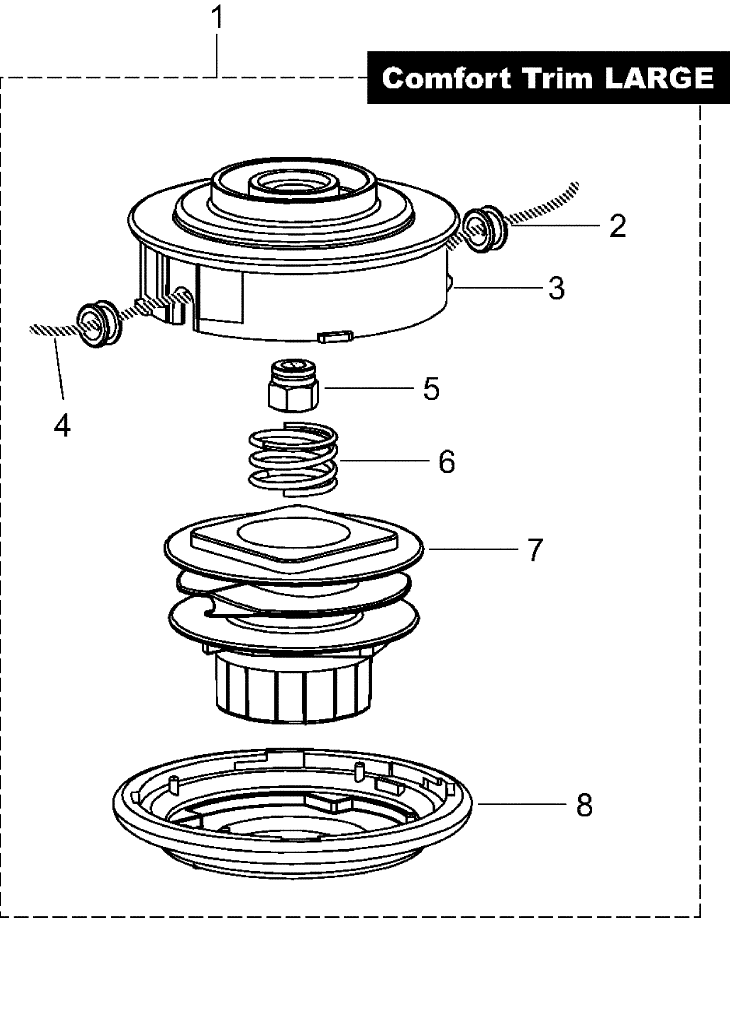
Červené šípky

Slide 4
Line trimming heads DOLMAR - 3m Tap&Go Comfort Trim "Large" 382224300
Pos. | Qty. | Part No. | Notes | Description | Specification | TI
1 | 1 | 382224300 |  | NYLON CUTTING HEAD | COMFORT TRIM LARGE
2 | 2 | 380224613 |  | EYELET
3 | 1 | 380224721 |  | HOUSING
4 | 1 |  |  | NYLON LINE | Ø 3,0 MM
5 | 1 | 382224310 |  | ADAPTER KIT | TAP&GO COMFORT TRIM LARGE
6 | 1 | 380224723 |  | SPRING
7 | 1 | 380224725 |  | SPOOL
8 | 1 | 380224728 |  | COVER

Slide 5
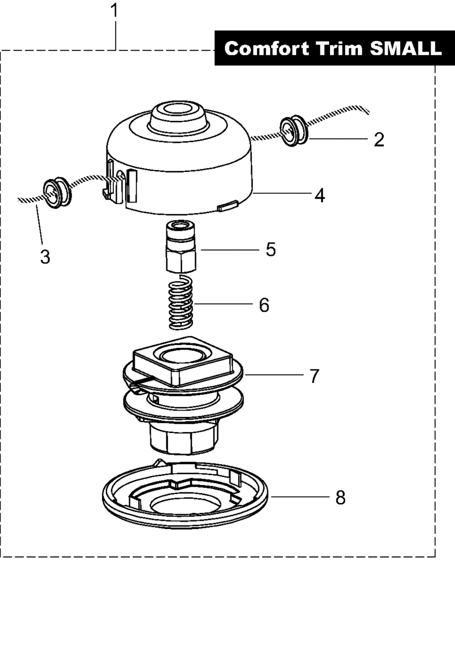
Zelené šípky

Slide 6
Line trimming heads DOLMAR - 3k Tap&Go Comfort Trim "Small" 680224200, 680224210
Pos. | Qty. | Part No. | Notes | Description | Specification | TI
1 | 1 | 680224200 |  | NYLON CUTTING HEAD | COMFORT TRIM SMALL (DOLMAR)
2 | 2 | 369224010 |  | THREAD BUSH
3 | 1 |  |  | NYLON LINE | Ø 2,0 MM
4 | 1 | 380224793 |  | HOUSING
5 | 1 | 680224600 |  | ADAPTOR
6 | 1 | 378224793 |  | SPRING
7 | 1 | 380224796 |  | SPOOL
8 | 1 | 380224798 |  | COVER

